Slide 1
Database System
Lecture 6

Slide 2
Relational Algebra
Relational Algebra is a procedural query language.
Relational algebra mainly provides a theoretical foundation for relational databases and SQL.
The main purpose of using Relational Algebra is to define operators that transform one or more input relations into an output relation.

Slide 3
Fundamental Operators
These are the basic/fundamental operators used in Relational Algebra.
Selection(σ)
Projection(π)
Union(U)
Set Difference(-)
Set Intersection(∩)
Rename(ρ)
Cross Product(X)

Slide 4
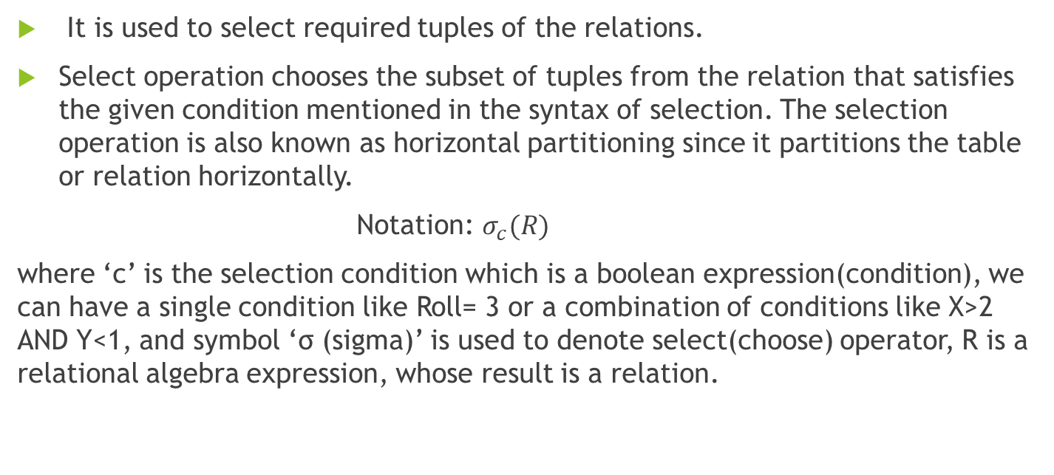
Selection(σ):
It is used to select required tuples of the relations.
Select operation chooses the subset of tuples from the relation that satisfies the given condition mentioned in the syntax of selection. The selection operation is also known as horizontal partitioning since it partitions the table or relation horizontally.
Notation: $σ_{c}(R)$
where ‘c’ is the selection condition which is a boolean expression(condition), we can have a single condition like Roll= 3 or a combination of conditions like X>2 AND Y<1, and symbol ‘σ (sigma)’ is used to denote select(choose) operator, R is a relational algebra expression, whose result is a relation.

Slide 5
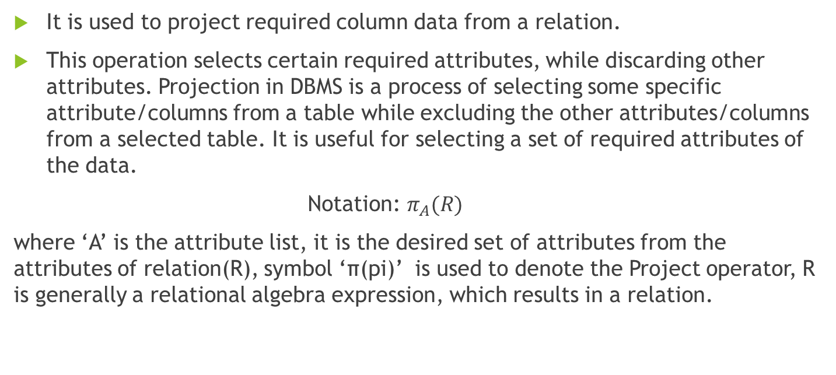
Projection(π)
It is used to project required column data from a relation.
This operation selects certain required attributes, while discarding other attributes. Projection in DBMS is a process of selecting some specific attribute/columns from a table while excluding the other attributes/columns from a selected table. It is useful for selecting a set of required attributes of the data.
Notation: $π_{A}(R)$
where ‘A’ is the attribute list, it is the desired set of attributes from the attributes of relation(R), symbol ‘π(pi)’ is used to denote the Project operator, R is generally a relational algebra expression, which results in a relation.

Slide 6

Union(U)
Union operation in relational algebra is the same as union operation in set theory.
Example: Consider the following table of Students having different optional subjects in their course.

Slide 7
French
Student_Name | Roll_Number
Ali | 01
Hamza | 02
Umar | 13
Bilal | 17
German
Student_Name | Roll_Number
Umar | 13
Bilal | 17
Hiba | 21
Sana | 25

Slide 8

Set Difference(-)
Set Difference in relational algebra is the same set difference operation as in set theory.
Example: From the above table of FRENCH and GERMAN, Set Difference is used as follows

Slide 9

Set Intersection(∩)
Set Intersection in relational algebra is the same set intersection operation in set theory.
Example: From the above table of FRENCH and GERMAN, the Set Intersection is used as follows

Slide 10
Rename(ρ)
Rename is a unary operation used for renaming attributes of a relation.

Slide 11
Cross Product(X)
Cross-product between two relations. Let’s say A and B, so the cross product between A X B will result in all the attributes of A followed by each attribute of B. Each record of A will pair with every record of B.

Slide 12

A
Name | Age | Sex
Ali | 14 | M
Alina | 15 | F
Hassan | 20 | M
B
ID | Course
1 | Computer
2 | Software Engineering
A$×$B
Name | Age | Sex | ID | Course
Ali | 14 | M | 1 | Computer
Ali | 14 | M | 2 | Software Engineering
Alina | 15 | F | 1 | Computer
Alina | 15 | F | 2 | Software Engineering
Hassan | 20 | M | 1 | Computer
Hassan | 20 | M | 2 | Software Engineering

Slide 13
Derived Operators
These are some of the derived operators, which are derived from the fundamental operators.
Natural Join(⋈)
Conditional Join

Slide 14
Natural Join(⋈):
Natural join is a binary operator. Natural join between two or more relations will result in a set of all combinations of tuples where they have an equal common attribute.
Natural join between EMP and DEPT with condition :
EMP.Dept_Name = DEPT.Dept_Name
EMP ⋈ DEPT
Name | ID | Dept_Name | Manager
A | 120 | IT | A
C | 110 | Sales | Y
D | 111 | IT | A

Slide 15
EMP
Name | ID | Dept_Name
A | 120 | IT
B | 125 | HR
C | 110 | Sales
D | 111 | IT
DEPT
Dept_Name | Manager
Sales | Y
Production | Z
IT | A

Slide 16
Conditional Join
Conditional join works similarly to natural join. In natural join, by default condition is equal between common attributes while in conditional join we can specify any condition such as greater than, less than, or not equal.
A
B
ID | Sex | Marks
1 | F | 45
2 | F | 55
3 | F | 60
ID | Sex | Marks
10 | M | 20
11 | M | 22
12 | M | 59

Slide 17
Conditional Join
Join between R and S with condition R.marks >= S.marks
R.ID | R.Sex | R.Marks | S.ID | S.Sex | S.Marks
1 | F | 45 | 10 | M | 20
1 | F | 45 | 11 | M | 22
2 | F | 55 | 10 | M | 20
2 | F | 55 | 11 | M | 22
3 | F | 60 | 10 | M | 20
3 | F | 60 | 11 | M | 22
3 | F | 60 | 12 | M | 59

